Slide 1

Event Hub
Group 2

Slide 2
Team Members
202412079-Rajvi Khatri
202412013-Parth Chauhan
202412101-Yashvi Shah
202412119-Ritik Kalal
202412026-Tisha Jain
202412029-Preksha Joshi
202412066-Dhruv Patel
202412032-Kaival Shah

Slide 3
Added New Feature
Description:
A digital event passport that stores all events attended by a user.
It tracks their participation and gives real rewards like free entries or heavy discounts based on how many events they attend.
User Story:
As a user, I want a digital event passport so I can see my event history and unlock real perks such as free events or big discounts.
For example: After attending 5 events, the user gets 40% off on any ticket.

Slide 4
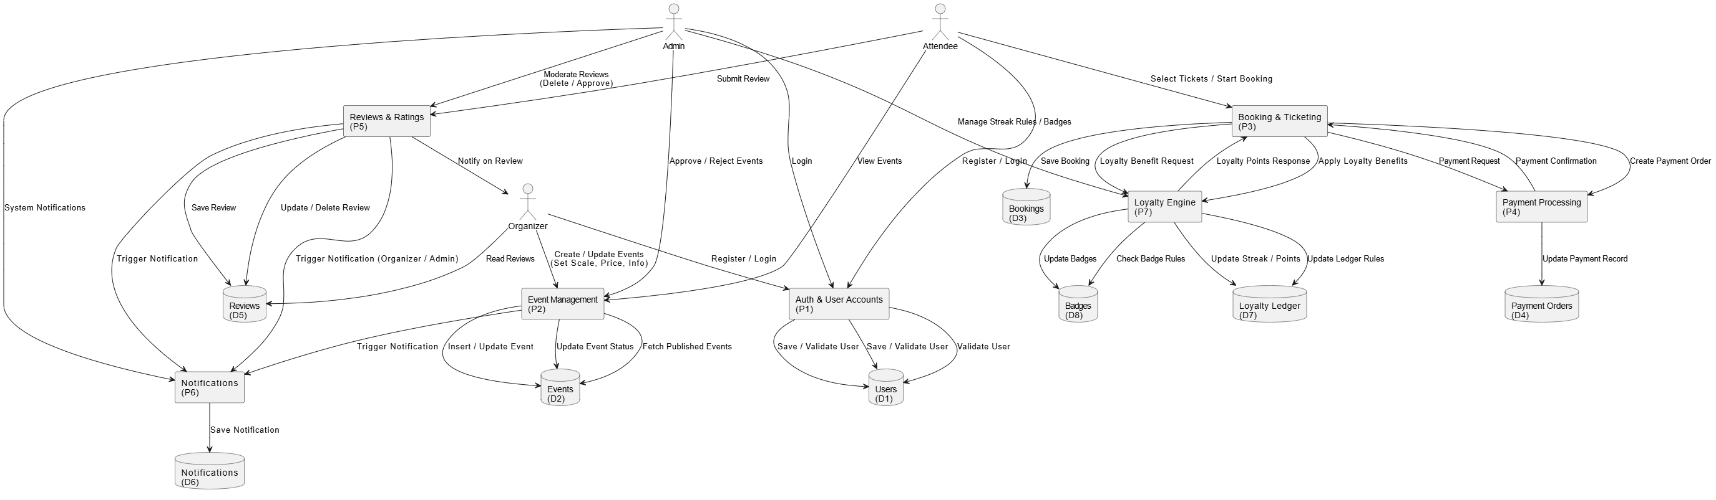
Data Flow Diagram (Level 1)

Slide 5
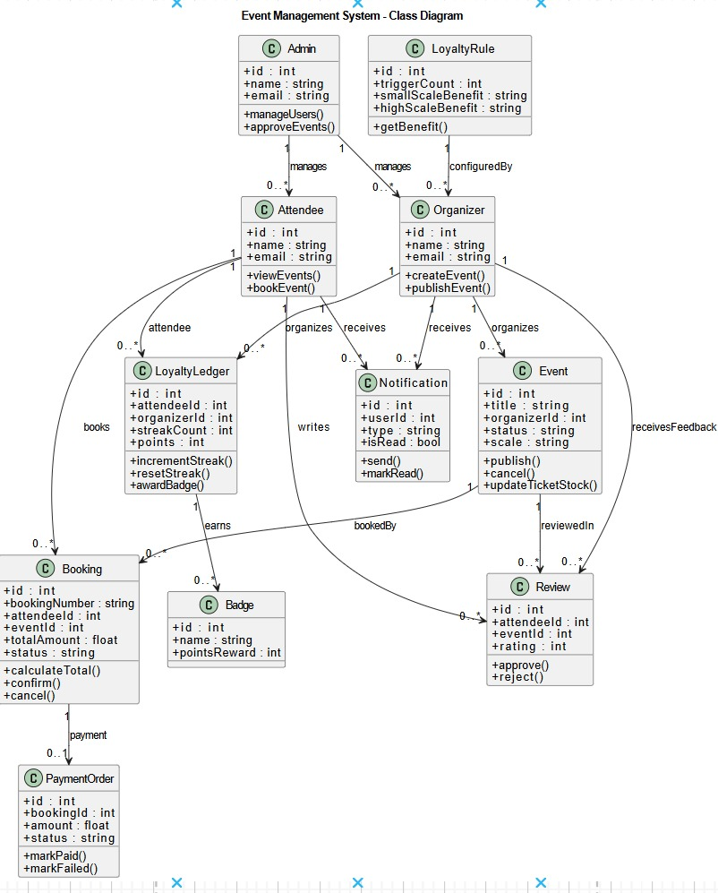
Class Diagram

Slide 6
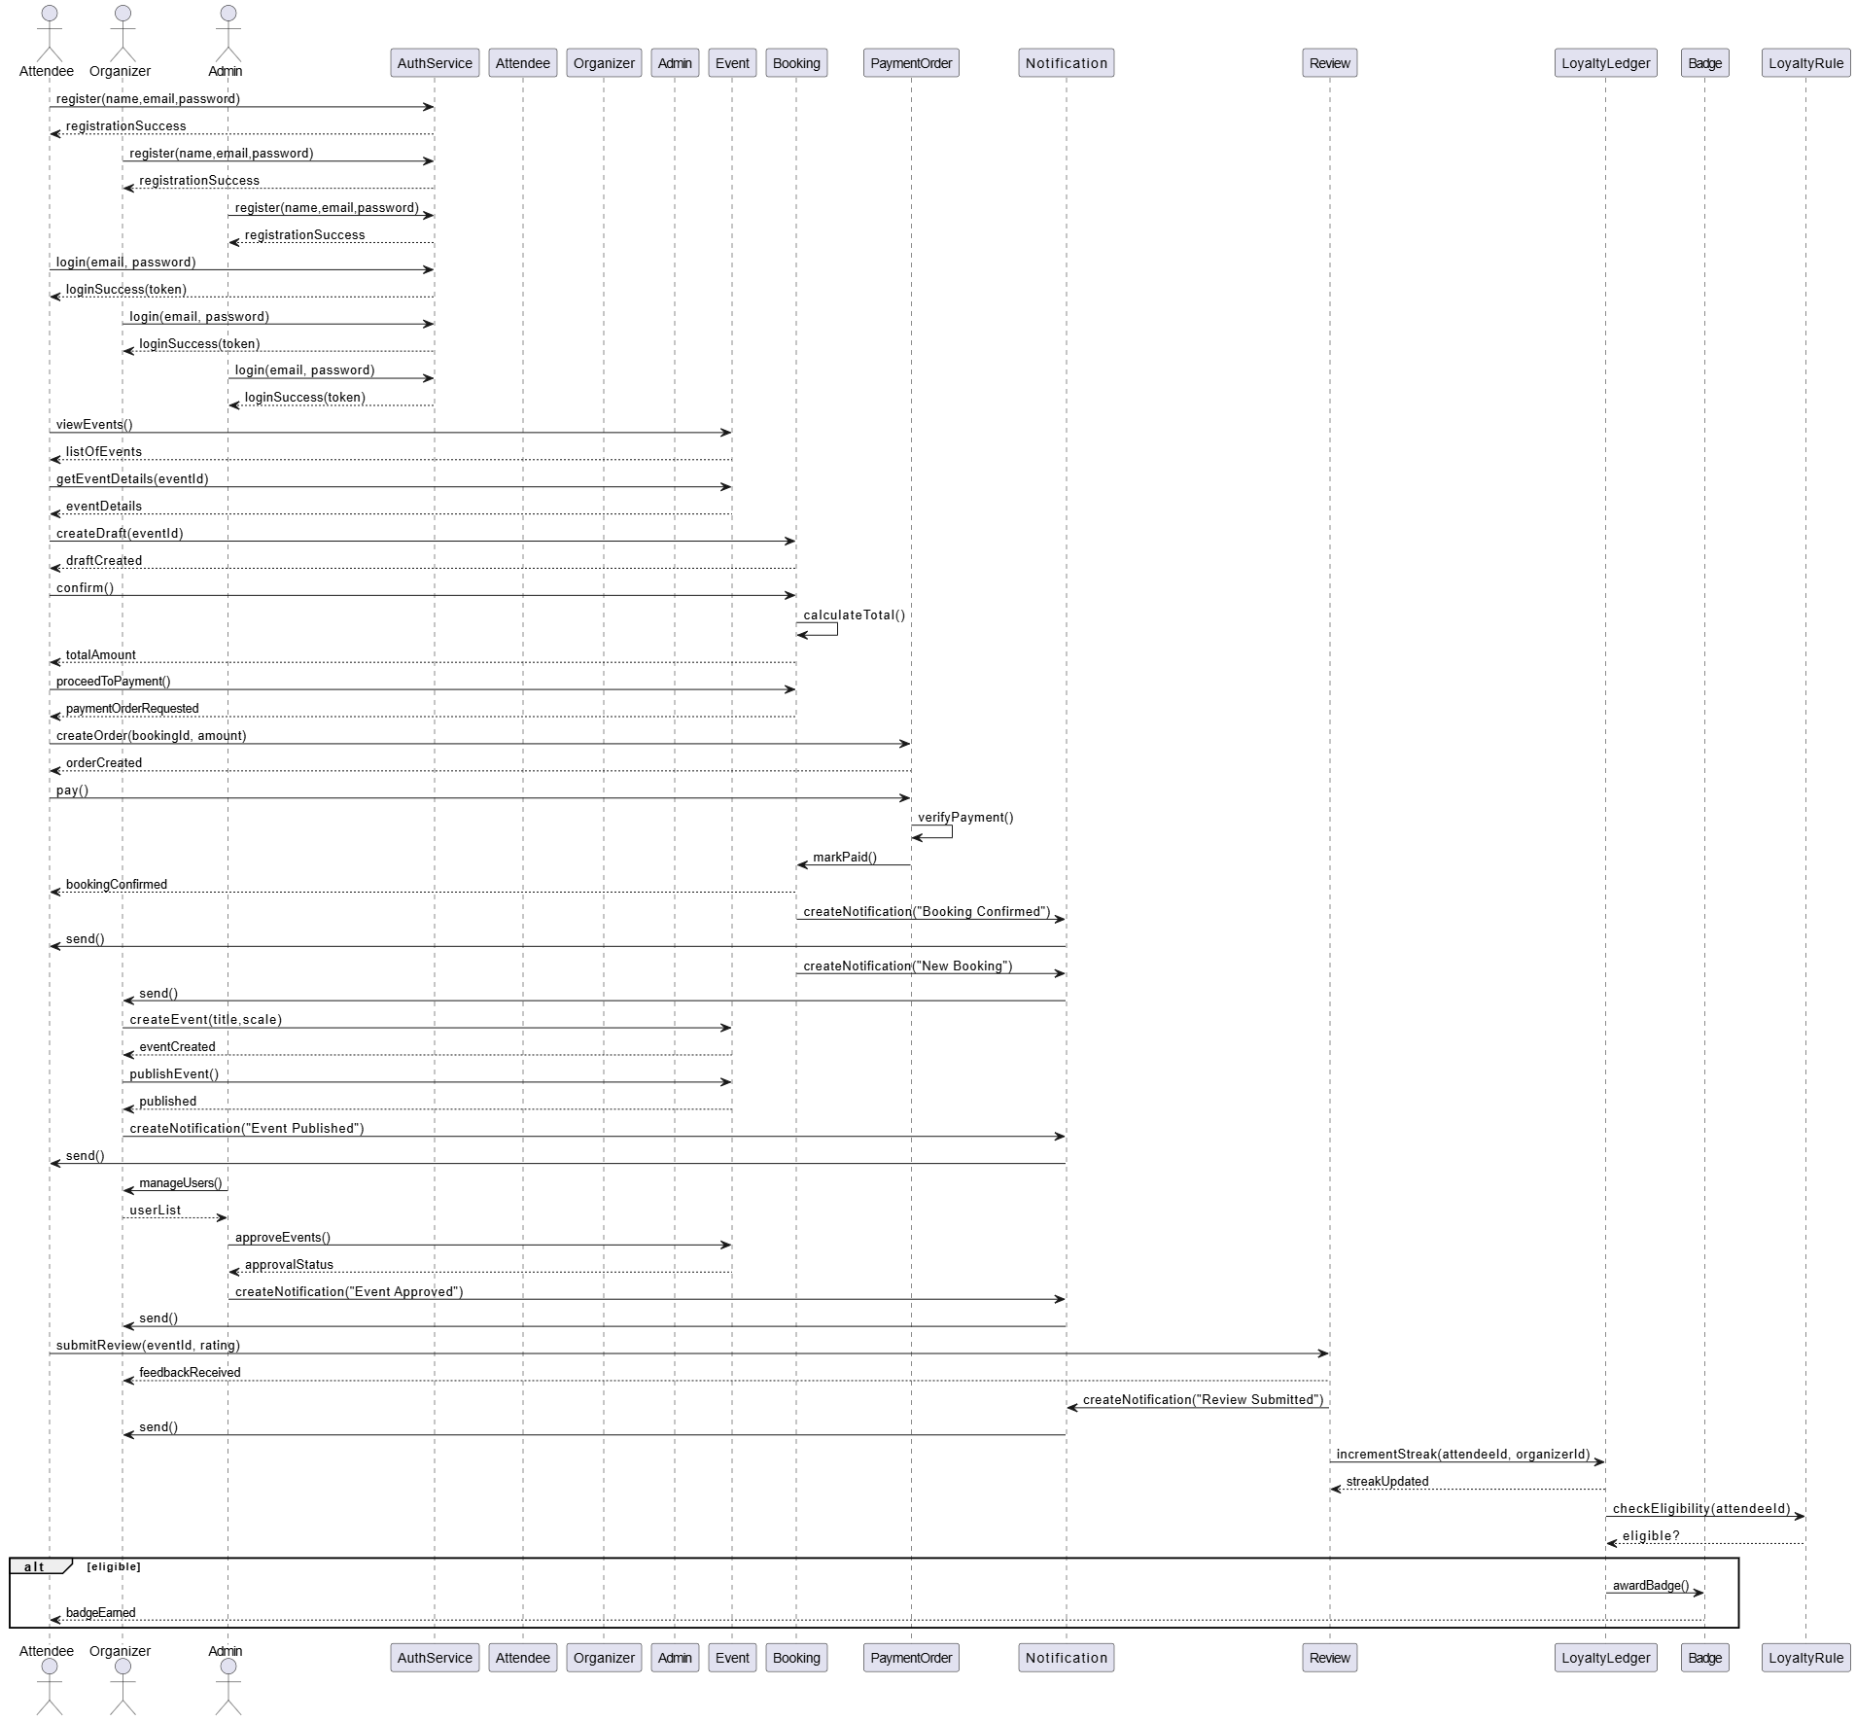
Sequence Diagram

Slide 7
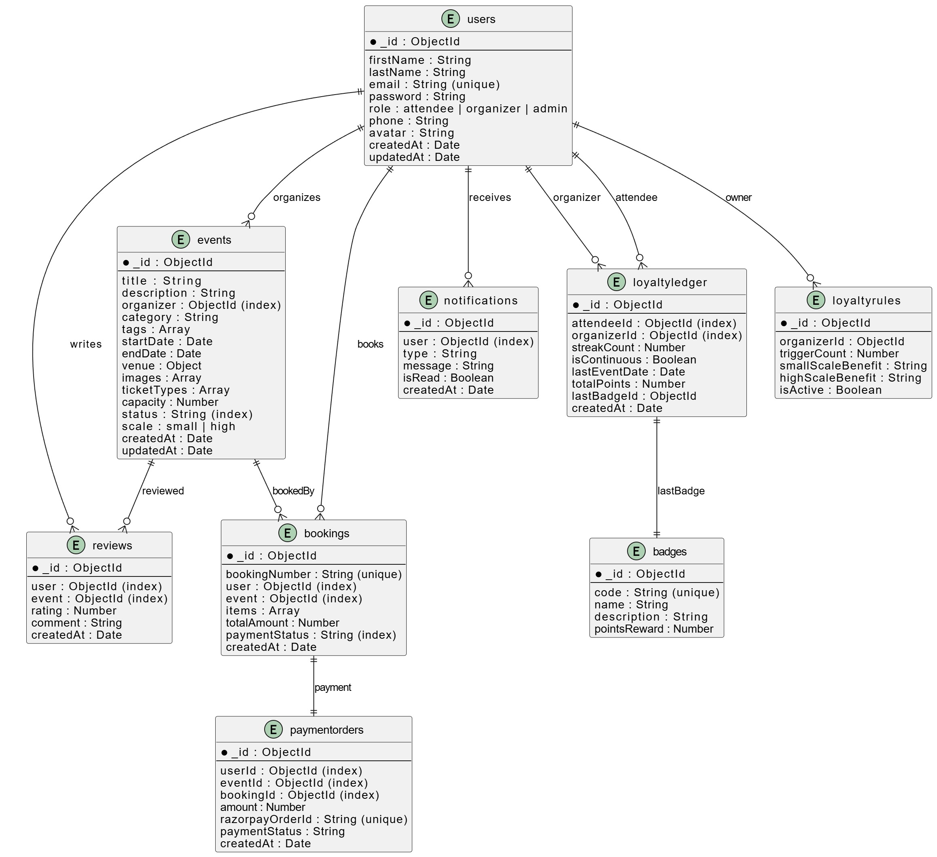
Schema Diagram

Slide 8
Factory Pattern
Definition:
Creates objects without exposing creation logic; lets subclasses decide which class to instantiate.
Why Used:
Dynamic creation of payment providers.
Multiple notification channels (Email/SMS/In-App).
Easy future extension.
Where Used:
PaymentService → chooses correct payment handler.
NotificationService → selects message sender.

Slide 9
Strategy Pattern
Definition:
Defines interchangeable algorithms; selects behavior at runtime.
Why Used:
Event benefits vary by scale (Free ticket vs Discount).
Where Used:
LoyaltyService → benefit calculation strategies.

Slide 10

Observer Pattern
Definition:
Event triggers automatic updates to multiple listeners.
Why Used:
Booking confirmation → notify attendee
Review submitted → notify organizer
Event published → notify users
Where Used:
NotificationService listens to creation, review, and payment events.

Slide 11
Singleton Pattern
Definition:
Ensures a single instance of a class throughout the application.
Why Used:
One MongoDB connection
One Razorpay client
One LoyaltyService instance
Where Used:
DB connection module
Payment gateway client
Loyalty rule handler

Slide 12

State Pattern
Definition:
Object behavior changes based on its internal state.
Why Used:
Booking: pending → confirmed → cancelled
Payment: pending → paid → failed → refunded
Event: draft → published → completed
Where Used:
Booking.status
PaymentOrder.status
Event.status

Slide 13
Thank You

